Slide 1
Nav Rule “Lite” for Recreational Boaters (In Plain English)
Richard G. Heller, J.D., Ph.D., Public Education Instructor
U.S. Coast Guard Auxiliary, District 11sr
© 2014
Note well: Every recreational boater should own the latest printed version of the Navigation Rules and read them cover to cover. This brief presentation is no substitute for the actual rules themselves. The purpose of this brief presentation is to encourage you to purchase a copy of the actual rules and read them in their entirety!
Notes:
These slides introduce basic concepts for the recreational boater; they are not intended for the education of the professional mariner. These slides are intended to be presented to an audience (e.g., yacht clubs and marinas) with a knowledgeable discussion leader.

Slide 2
Purpose of the Rules
Collision avoidance!
International Rules—U.S. Treaty Obligation
Inland Rules—Promulgated by the Coast Guard pursuant to Title 33 U.S.C. § 2071
[Note: Under Rule 2, these rules must be complied with unless a departure from them is necessary to avoid immediate danger]
Notes:
The standard professional textbook is Farwell’s Rules of the Nautical Road. Chapman’s Piloting & Seamanship is recommended for the recreational power boater; The Annapolis Book of Seamanship is recommended for the sailor.

Slide 3
Basic Context
Navigation Rules to prevent collision
Deals with limited situations—head-on, crossing, and overtaking
Deals with both unrestricted and restricted visibility—lights, shapes, sound signals
Notes:
In collision situations admiralty law applies the doctrine of comparative negligence or comparative fault. In many situations, liability will be apportioned based upon fault.

Slide 4
Key Concepts
I. Observe the “Practice of Good Seamanship”
II. Always give way to the less maneuverable vessel and do not impede its passage
III. Let other vessels know who you are, where you are, and what you’re doing (lights, shapes, sound signals)
Notes:
Prudent seamanship (or, as stated in Rule 2, “the ordinary practice of seamen”) may be defined by boating books such as Chapman’s Piloting and Seamanship and The Annapolis Book of Seamanship. Simple courtesy and common sense may resolve a number of difficult on-the-water issues.

Slide 5
I. Practice Prudent Seamanship
Always maintain a “proper look-out” [Rule 5]
Always “proceed at a safe speed” so that you can stop your vessel in order to avoid a collision with another vessel [Rule 6]
Always anticipate potential collision situations and maintain situational awareness to avoid a collision [Rules 7 & 8]
Notes:
Most collisions are due to violations of Rules 5 & 6. An untrained person is not a “proper” look-out. In addition, in congested breakwaters and harbors, multiple look-outs may be required. If you have radar and AIS, use it! NAVSAC Resolution 97-01 deems solo sailing to be an “inherently dangerous activity.” Among other factors, “safe-speed” requires attention to visibility, congestion and hazards to navigation, and vessel maneuverability. Practice defensive boating as you would practice defensive driving.

Slide 6
II. Maneuverability
Always “keep out of the way of” a less maneuverable vessel [Rule 18]
Always “take early and substantial action” to keep out of the way of a less maneuverable vessel [Rule 16]
Sailing vessels are not necessarily privileged vessels [Rule 18]
Notes:
Vessel maneuverability is the key to avoiding potentially dangerous close-quarters situations. Recreational vessels are inherently more maneuverable than commercial vessels. Unfortunately, the Nav Rules do not deal with human-powered vessels. Great care must be taken whenever canoes, row boats, paddle boards, and kayaks are likely to be present.

Slide 7
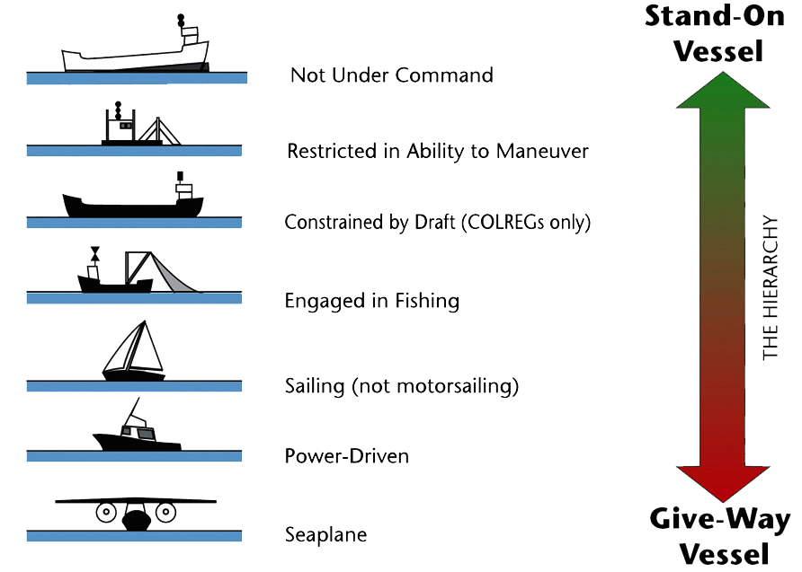
Maneuverability
Notes:
Unfortunately, Rule 18 does not consider “human powered” vessels. Such vessels (e.g., kayaks, row boats, canoes, paddle boards, and the like) present a special hazard in harbor areas.

Slide 8
III. Vessel Identification
Use proper day shapes for signaling by day
Use proper lights for signaling at night
Use proper sound signals for maneuvers in close-quarters and in conditions of restricted visibility
Notes:
Few recreational vessels display day shapes, although they should when aground or at anchor. Unfortunately, even fewer use any sound signals.

Slide 9
The Head-On Situation
Most dangerous because vessels approach each other at the sum of their individual speeds
Take positive and large action in ample time to pass “port-to-port” (i.e., turn to starboard)
Do not turn to port unless a starboard turn is dangerous
Allow sufficient distance between vessels for safe passage
Notes:
At night, the radar image contact may be difficult to see because of the angle of the bow of the oncoming vessel.

Slide 10
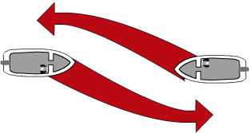
Port-to-Port Passing
Give-way
Notes:
Each vessel should make an early and a pronounced turn to starboard. Allow sufficient sea room—passing recreational vessels should not crowd each other.

Slide 11
The Overtaking Situation
The rate of approach is the difference between the two speeds
Extremely dangerous in a narrow channel or fairway, but the overtaken vessel should be on the right-hand side of the channel or fairway (i.e., prudent seamanship means you pass on the left)
Navigation Rules impose most of the responsibility on the overtaking vessel!
Notes:
A good rule is to avoid overtaking another vessel in a narrow channel or fairway due to the risk of unfavorable hydrodynamic interaction between the two vessels (i.e., sheer and bank suction).

Slide 12
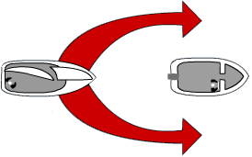
Overtaking Another Vessel
Stand-on Vessel
Give-way
Vessel
Notes:
Passing on either side is permissible except in a narrow channel or fairway. In a narrow channel or fairway, you should pass to the left. See Rule 9(a), which requires vessels to keep “as near to outer limit of the channel … which lies on her starboard side as is safe and practicable.”

Slide 13
The Crossing Situation
Be aware of your vessel’s starboard bow “danger zone”
For safety, pass behind the stern of the other vessel by making an early and substantial turn to starboard
Or, consider being courteous and allowing the other vessel to pass ahead of you
Notes:
As a matter of courtesy, the give-way vessel may slow down to allow the stand-on vessel to enjoy safe passage and adequate sea room.

Slide 14
The Implicit Danger Zone
Notes:
The implicit danger zone is from 0° to 112.5° for stand-on crossing vessels.

Slide 15
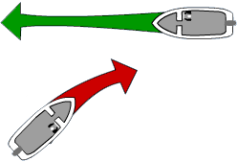
Turning to Starboard to Pass Astern
Stand-on Vessel
Give-way Vessel
Notes:
Note the give-way vessel’s pronounced turn to starboard to pass astern of the crossing or stand-on vessel.

Slide 16
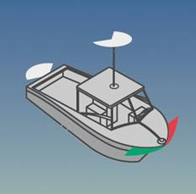
Power Boat Lights
One or two masthead lights
Red & green sidelights
A sternlight
[Note: vessels under 39 ft.
in length may show an all-round
white light and sidelights]
Notes:
In general, see Rules 23(a) and 23(d) (applicable to smaller power-driven vessels). A vessel of 50 meters (164 ft.) or more in length must show a second masthead light. If a power-driven vessel is under 12 meters (39 ft.) in length, she may exhibit an all-round white light and sidelights (with no sternlight and no masthead light).

Slide 17
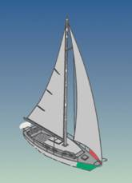
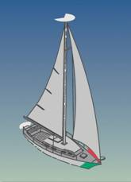
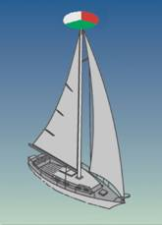
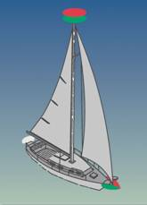
Sailing Vessel Lights
Red & green sidelights
A sternlight
[Note: there are special
light options for
sail boats]
Notes:
Rule 25 allows certain sailing vessels to use a combination latern light and, under certain conditions, a “red over green” top mast light.

Slide 18
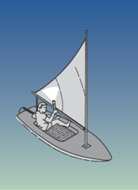
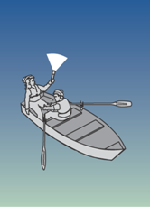
Small Vessel Lights
Applies to sail boats
under 23 ft. in length
and non-powered boats
A white flashlight or lantern must be exhibited in sufficient time to prevent a collision
Notes:
This stems from Rule 25(d)(i), (ii). Small power-driven vessels are also required to exhibit an all-round white light. See Rule 23(d)(ii).

Slide 19
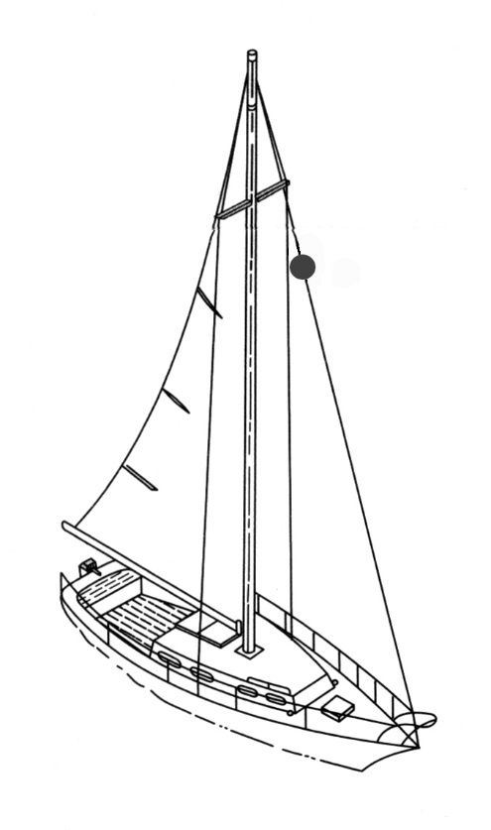
At Day Anchor
Notes:
Notice the spherical black ball day shape—same for a power boat. See Rule 30(a). Do not confuse with the black conical shape, apex downwards, prescribed by Rule 25(e) for sail boats under auxiliary engine power.

Slide 20
At Anchor at Night
Note: Under Inland Rule 30(g) and 33 CFR § 109.10, for vessels under 65 ft. in length an anchor light is not required in special designated anchorage areas. For Clarity and thoroughness, the applicable Coast Pilot must be consulted.
Copyright 2014 - Coast Guard Auxiliary Inc.
Notes:
An all-round white light is almost always required to be displayed. Even if not required in limited circumstances, the display is highly recommended. See Rule 30.

Slide 21
Diving Operations
Diving operations require a
special flag during the day and “red-white-red” vertical lights at night
Always keep a safe distance
from vessels engaged in
diving operations (at least 100
yards)
Notes:
See Rule 27(e). Keeping a safe distance means safety for persons underwater.

Slide 22
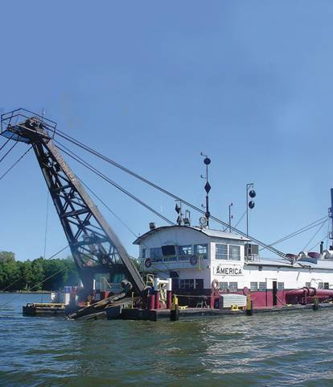
Dredging Operations
Always pass on the
“diamond” side (two diamonds in a vertical line), never on the “ball” side
Better yet, call the
dredge to make certain it is safe to pass
Notes:
See Rule 27(d). The LNM will usually contain the dredge’s VHF operating channel and a cellular telephone number for contact purposes. Follow the dredge operator’s safe passing instructions.

Slide 23
Maneuvering Signals
Inland Rules seek permission and require an affirmative or negative response (danger signal—at least 5 short and rapid blasts) from the other vessel
Maneuvering signals are mandatory but typically ignored by recreational boaters because they are unfamiliar with them (recreational boaters should learn the basic signals)
Notes:
Under Rule 34(e), which deals with bends and intervening obstructions, both the International Rule and the Inland Rule require an answer from any approaching vessel. See also Rule 9(f).

Slide 24
Restricted Visibility
The sounding of fog signals is necessary to indicate vessel presence, including vessels aground or at anchor
Prudent seamanship may require that fog signals be given more often than the rules literally require
Notes:
See Rule 35 for the various vessel fog signal requirements. Remember, in heavy fog you will not see a vessel’s lights until it is too late. AIS and radar are critical for navigation under conditions of restricted visibility.

Slide 25
Sound Signals
FLAG HOIST |  | FLAG MEANING | MORSE CODE | NAV RULES MEANING
 | Echo | I am altering my course to starboard | ● | I am altering my course to starboard
 | India | I am altering my course to port | ● ● | I am altering my course to port
 | Sierra | I am operating with astern propulsion | ● ● ● | I am operating with astern propulsion
 | Tango | Keep clear of me | ▬ | A power driven vessel making way
 | Delta | I am maneuvering with difficulty | ▬ ● ● | Sailing, towing, commercial fishing, NUC, RAM, CBD
 | Mike | I am making no way | ▬ ▬ | A power driven vessel underway with no way on
 | Romeo | The way is off my ship | ● ▬ ● | A vessel at anchor
 | Bravo | Dangerous Cargo | ▬ ● ● ● | A towed vessel or the last vessel of a manned tow
Notes:
In the days of sail, ships declared their intentions or status with signal flags. As wireless gradually supplanted flags as the primary means of communication, Morse Code for the letters signified by the flag hoist became the established sound signals for maneuvering and during periods of restricted visibility. The danger signal is at least five short and rapid whistle blasts. See Rule 34(d). Note: NUC = vessel not under command, RAM = vessel restricted in her ability to maneuver, CBD = vessel constrained by her draft. See Rule 3. Recreational boaters should learn these basic signals. The Morse Code sound blasts will be made by whistle; e.g., one short blast (Morse “E”) indicates an alteration of course to starboard.

